Slide 1
Zooplankton heatwaves deep dive

Slide 2
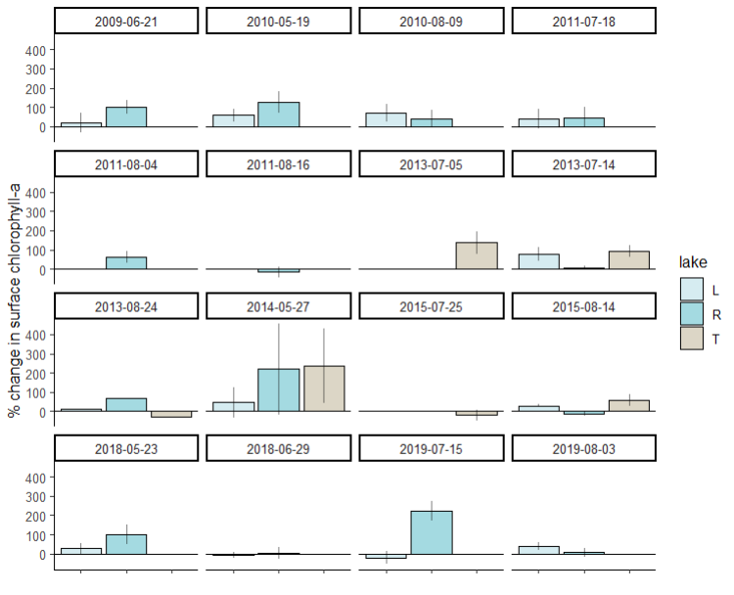
Goal: explain variation in percent change in chlorophyll during heatwaves
Error bars are standard deviation
Of the five percent changes we averaged

Slide 3
Conceptual figure – what we might expect
Heatwave
Zooplankton
Chl

Slide 4
Gravimetric zooplankton

Slide 5
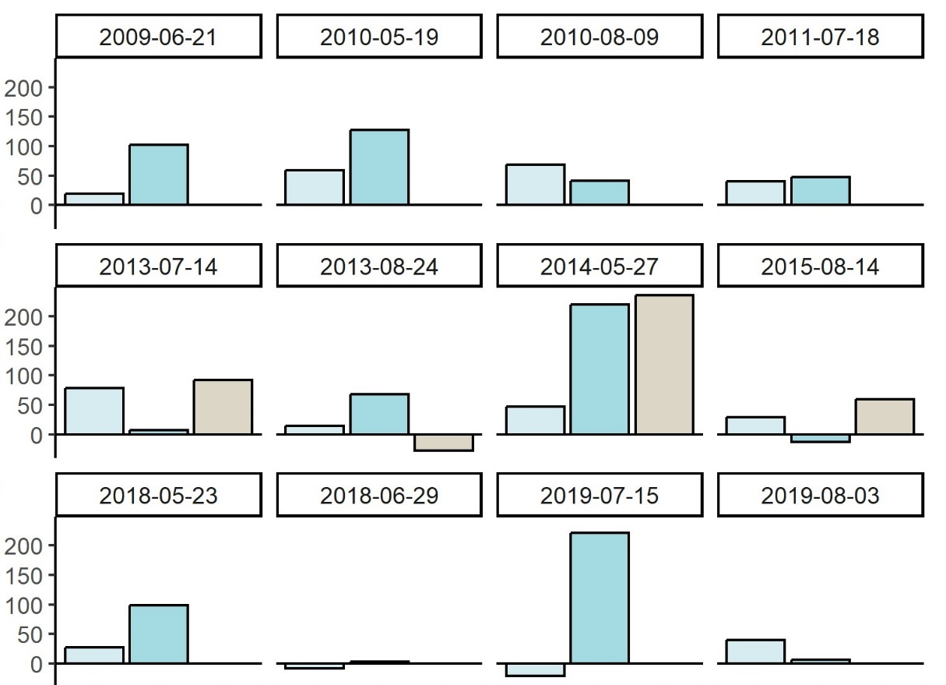
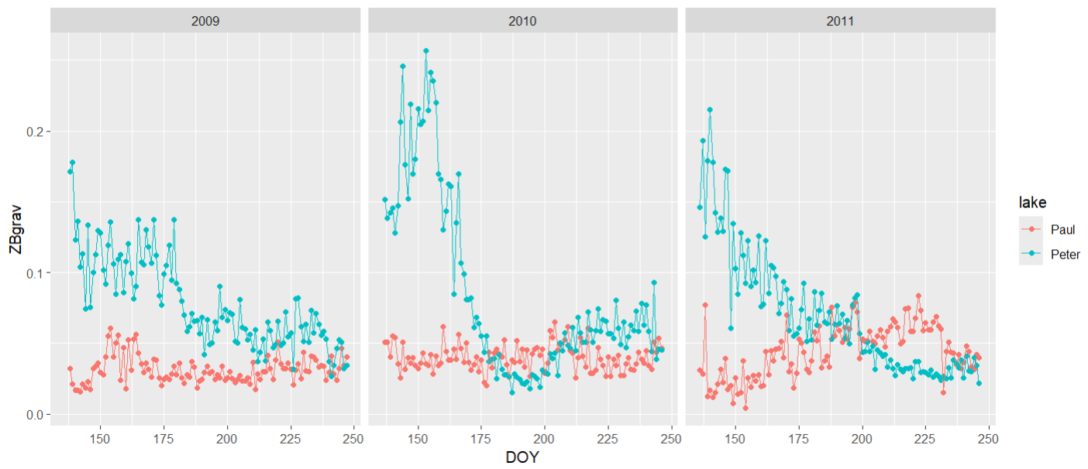
Gravimetric zooplankton
Notes:
Gravimetric zooplankton

Slide 6
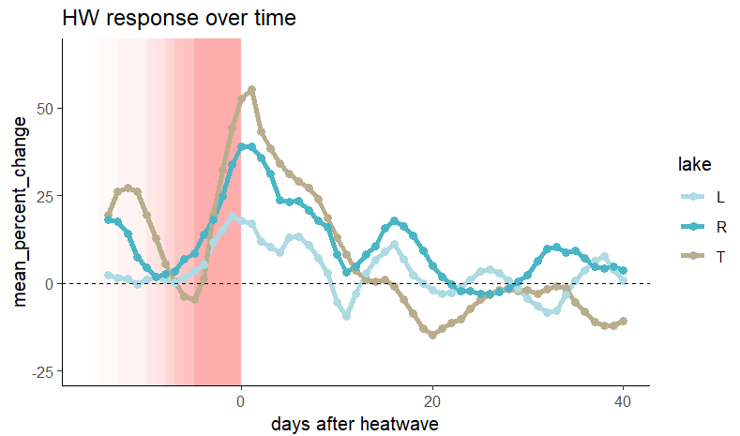
Percent change in chlorophyll relative to heatwave timing -- ALL YEARS
Percent change in chlorophyll over time, relativized to the end date of the heatwave and averaged over all heatwave events for each lake. Each heatwave is represented by a pink box (heatwaves range in duration from 5 to 16 days). Each point represents the percent change over the preceding 7 days. A point at the end of the heatwave window, then, (where chlorophyll percent change is highest), represents the time period of the last 7 days of the heatwave. When I get the distributions of percent changes, I take the five points from day 0 after the heatwave, onward.

Slide 7
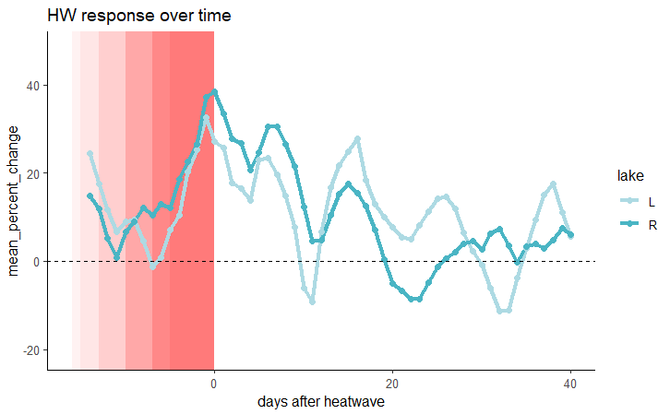
Percent change in chlorophyll relative to heatwave timing -- 2008 to 2011

Slide 8
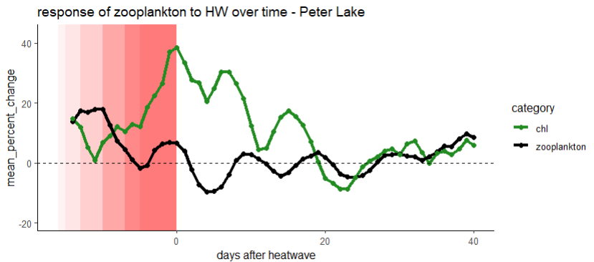
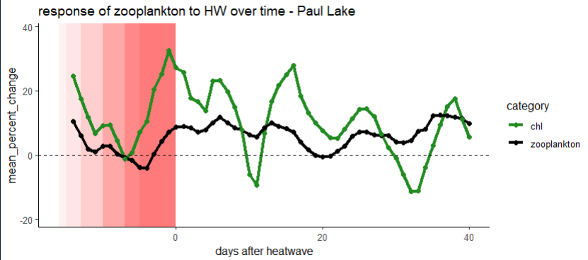
Grav zoops 2008-2011
Here, I applied the same rolling slopes analysis to daily zooplankton that I applied to chlorophyll. There is a small dip in the percent change in zooplankton corresponding to the mean start date of the heatwaves (~7 days before the end) before they increase and start grazing again

Slide 9
Routines Zooplankton

Slide 10
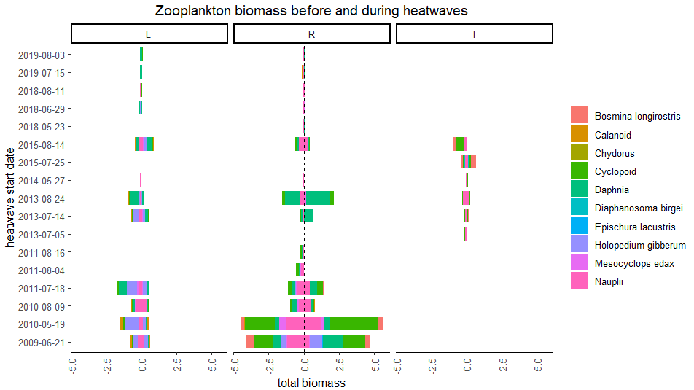
Zooplankton biomass before and during heatwave
Why is 2018 and 2019 biomass so low?
Before
During
Before
During
Before
During

Slide 11
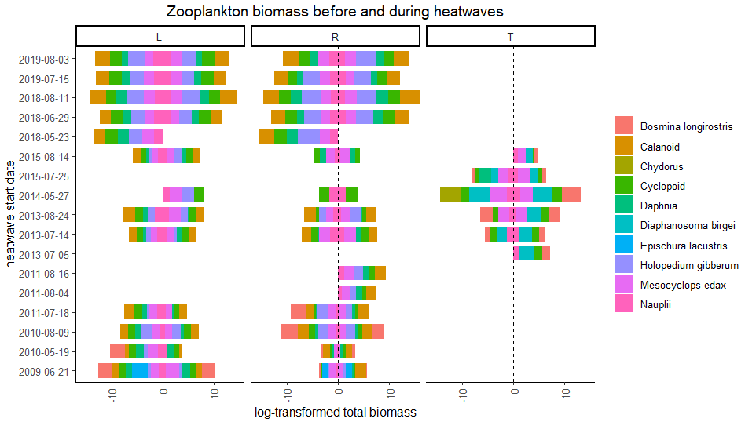
Log-transformed zooplankton biomass before and during heatwave
Before
During
Before
During
Before
During

Slide 12
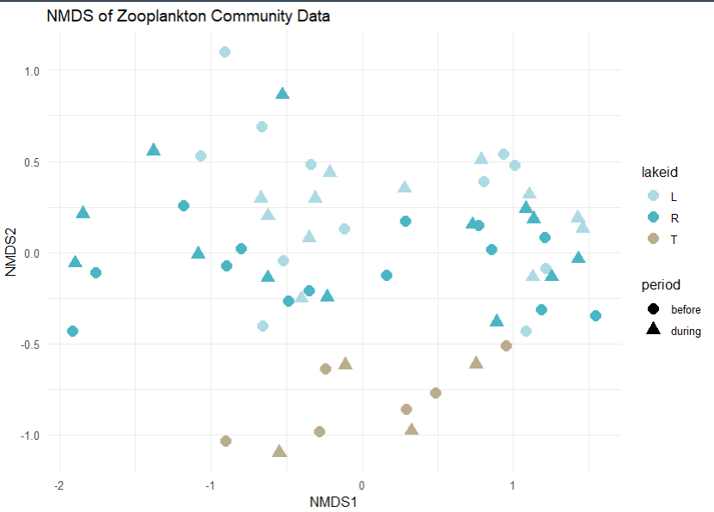
NMDS of zoop community composition before and during heatwaves- no patterns really pop out

Slide 13
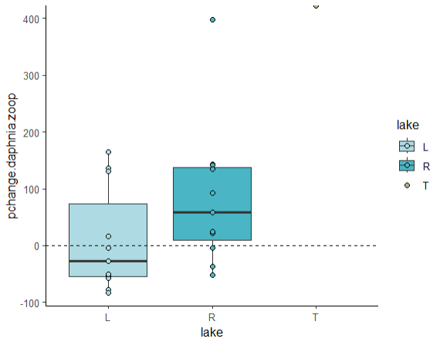
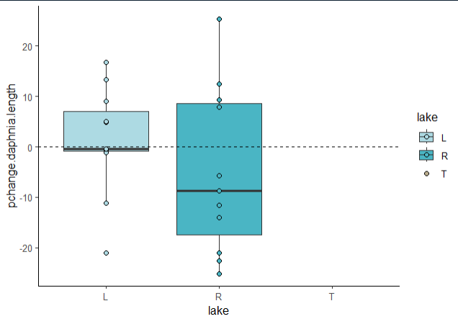
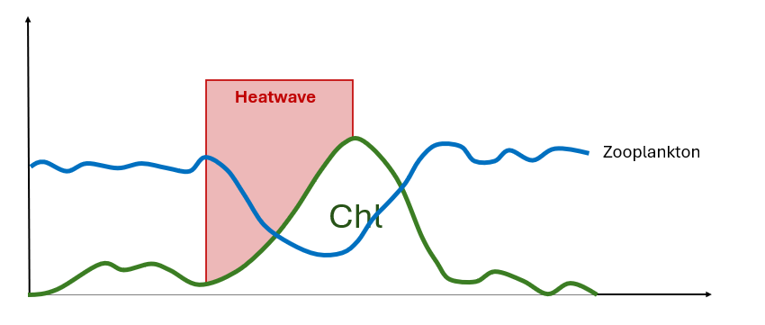
Percent change in Daphnia and Ceriodaphnia biomass from week before heatwave to during heatwave
Percent change in Daphnia and Ceriodaphnia length from week before heatwave to week during heatwave

